Slide 1

ONLINE BANKING
RLL GROUP-1

Slide 2

TEAM MEMBERS :
R. Nodankumar 2564563
U. Dasaratha Rami Reddy 2562947
B. Mahesh 2563697
P. Tejasri 2564180
K. V. Praneetha 2563138
T. Sravya 2563373
B. Anitha 2563568
Soumi Datta 2563944
Vurugonda Kalyan 2563458
Aruljothi S 2563845

Slide 3

CONTENTS
Introduction
Objective
Technologies Used
Spring cloud
Spring cloud-Netflix Eureka
Spring feign
Resilience4j
retry and circuit breaker
Sleuth and zipkin
Advantages
Flowchart
Architecture of java online banking app
Output
Conclusion

Slide 4
INTRODUCTION
In a rapidly changing technological landscape and evolving customer preferences, ICIN Bank is acknowledging the necessity for adaptation and evolution.
This presentation unveils ICIN's strategic plan to modernize its banking operations through the integration of Java Microservices and Spring Cloud .
The primary objective is to rejuvenate operations and enhance customer experiences, aligning the bank with the demands of the modern era.
Microservices are a modern approach to software whereby application code is delivered in small, manageable pieces, independent of others.
Why build microservices?
Their small scale and relative isolation can lead to many additional benefits, such as easier maintenance, improved productivity, greater fault tolerance, better business alignment, and more.

Slide 5
OBJECTIVES
The primary objective of this transformation is to:
Simplify Banking: The aim to make banking with ICIN as easy as possible for everyone, from beginners to experts.
Enhance Customer Experience: The aim is to provide a seamless, user-friendly, and efficient banking experience .
Stay Competitive: To keep up with the fast-paced changes in the banking industry, ensuring that our services are on par with or even better than those of larger, online-focused banks.
.

Slide 6
TECHNOLOGIES USED
The tools and languages used are:
1) Server-side: Spring Boot, Spring Cloud, Spring Data JPA.
2) Database: MySQL.
3) Server: Embedded Tomcat .
4) Git Hub
5) Spring Cloud: Spring Cloud Config, Spring Cloud Netflix Eureka, Feign, Resilience4j, Retry, Sleuth and Zipkin.

Slide 7
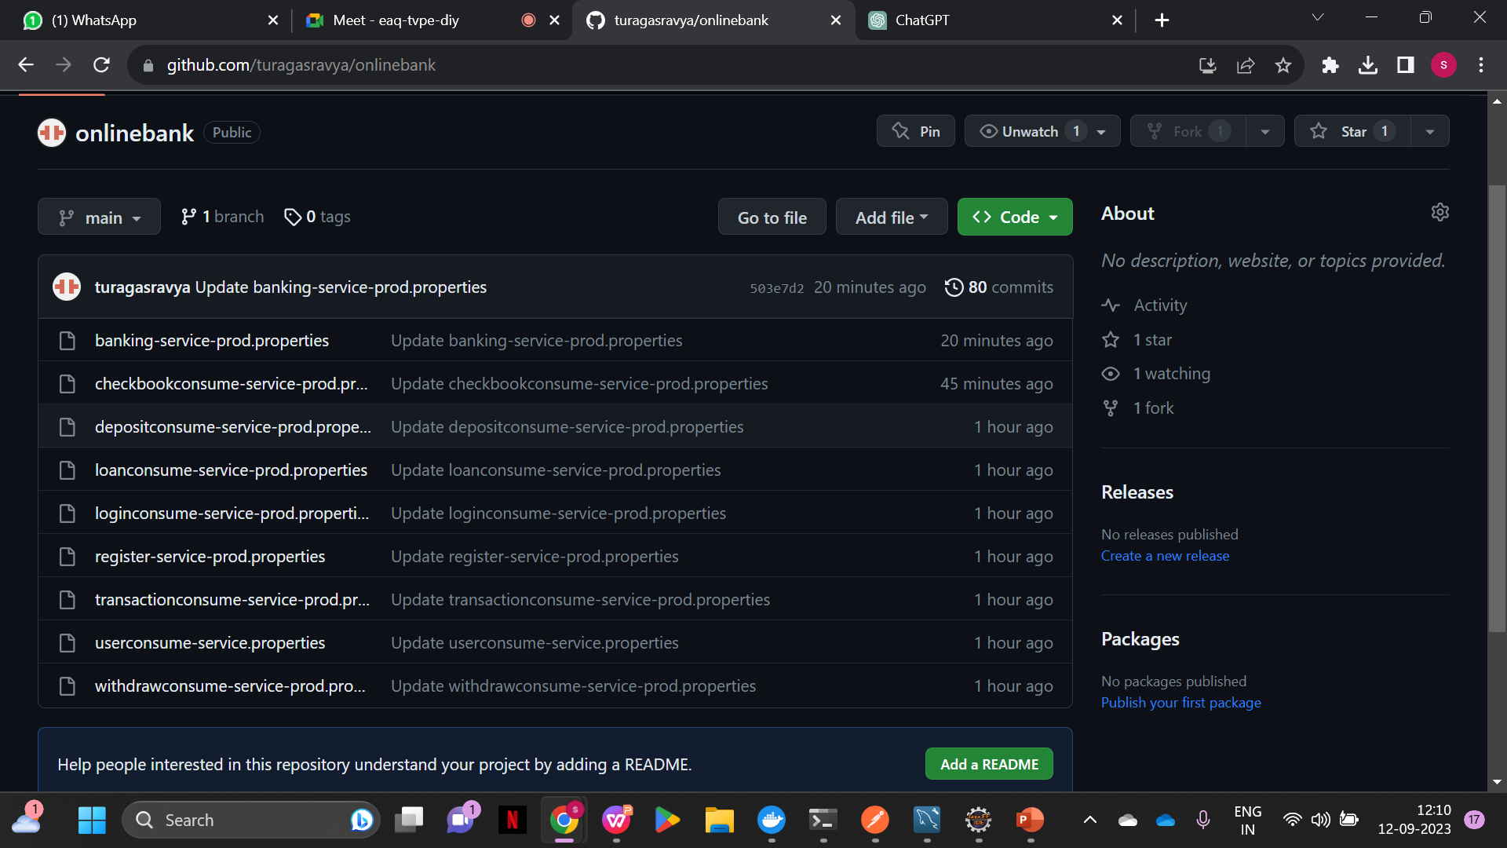
Spring cloud
Spring Cloud Config is Spring’s client/server approach for storing and serving distributed configurations across multiple applications and environments.

Slide 8
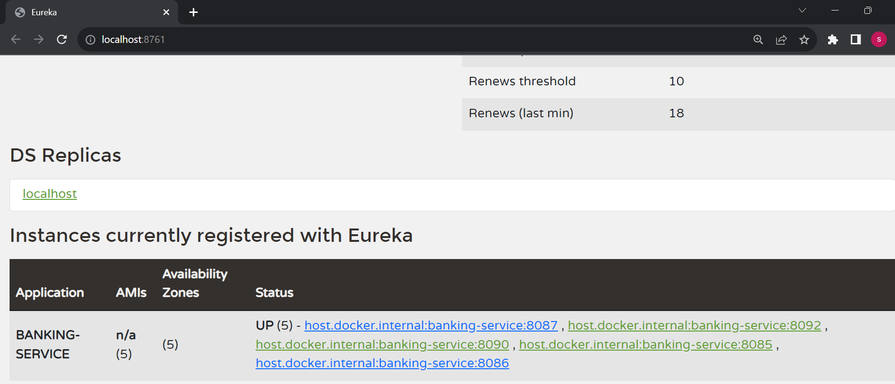
Spring cloud-Netflix eureka
Spring Cloud Netflix Eureka:
Client-side service discovery allows services to find and communicate with each other without hard-coding the hostname and port. The only ‘fixed point’ in such an architecture is the service registry, with which each service has to register.

Slide 9
Spring feign
Spring Cloud Feign offers a declarative approach for making RESTful service-to-service call in a synchronous way.
When using Feign, we write declarative REST service interfaces at the client, and use those interfaces to program the client.
Without Feign, in Spring Boot application, we use RestTemplate to call the User service. To use the Feign, we need to add spring-cloud-starter-openfeign dependency in the pom.xml file.
<dependency>
<groupId>org.springframework.cloud</groupId>
<artifactId>spring-cloud-starter-openfeign</artifactId>
</dependency>

Slide 10
Resilience 4j
Resilience4j is a lightweight fault tolerance library that provides a variety of fault tolerance and stability patterns to a web application.
Resilience4j provides higher-order functions (decorators) to enhance any functional interface, lambda expression or method reference with a Circuit Breaker, Rate Limiter, Retry or Bulkhead.
With Resilience4j you don't have to go all-in, you can pick what you need.

Slide 11
Retry and circuit breaker
RETRY:
Retry decorator will help you to retry the failed decoration.▪
If an error that takes place tells you that retrying can help you can repeat the same decoration otherwise use fallback method to return the predefined response.
Circuit breaker:
The circuit breaker is essentially a pattern that helps to prevent cascading failures in a system
The circuit breaker has three states:
1)Closed
2)Open
3)Half Open

Slide 12
Sleuth and zipkin
Sleuth is a distributed tracing system, often used with Spring Cloud, that enables monitoring and troubleshooting of microservices by tracking and visualizing the flow of requests across services.
Sleuth is used to generate and attach the trace id, span id to the logs so that these can then be used by tools like Zipkin.
Zipkin is an open-source distributed tracing system used for monitoring and debugging microservices-based applications by tracing and visualizing request flows across services.

Slide 13
Advantages
Staying Competitive: ICIN Bank can keep up with and even surpass online banking giants attracting and retaining more customers.
Happy Customers: Both administrators and regular users benefit from improved security, easy access to information, and convenient services, making them happier with their banking experience.
Scalability: Since each microservice runs independently it is easier to add , remove, update each cloud microservice.
Resilience: Java microservices act like safety nets, containing failures within one service to prevent them from disrupting the entire application and minimizing downtime.

Slide 14
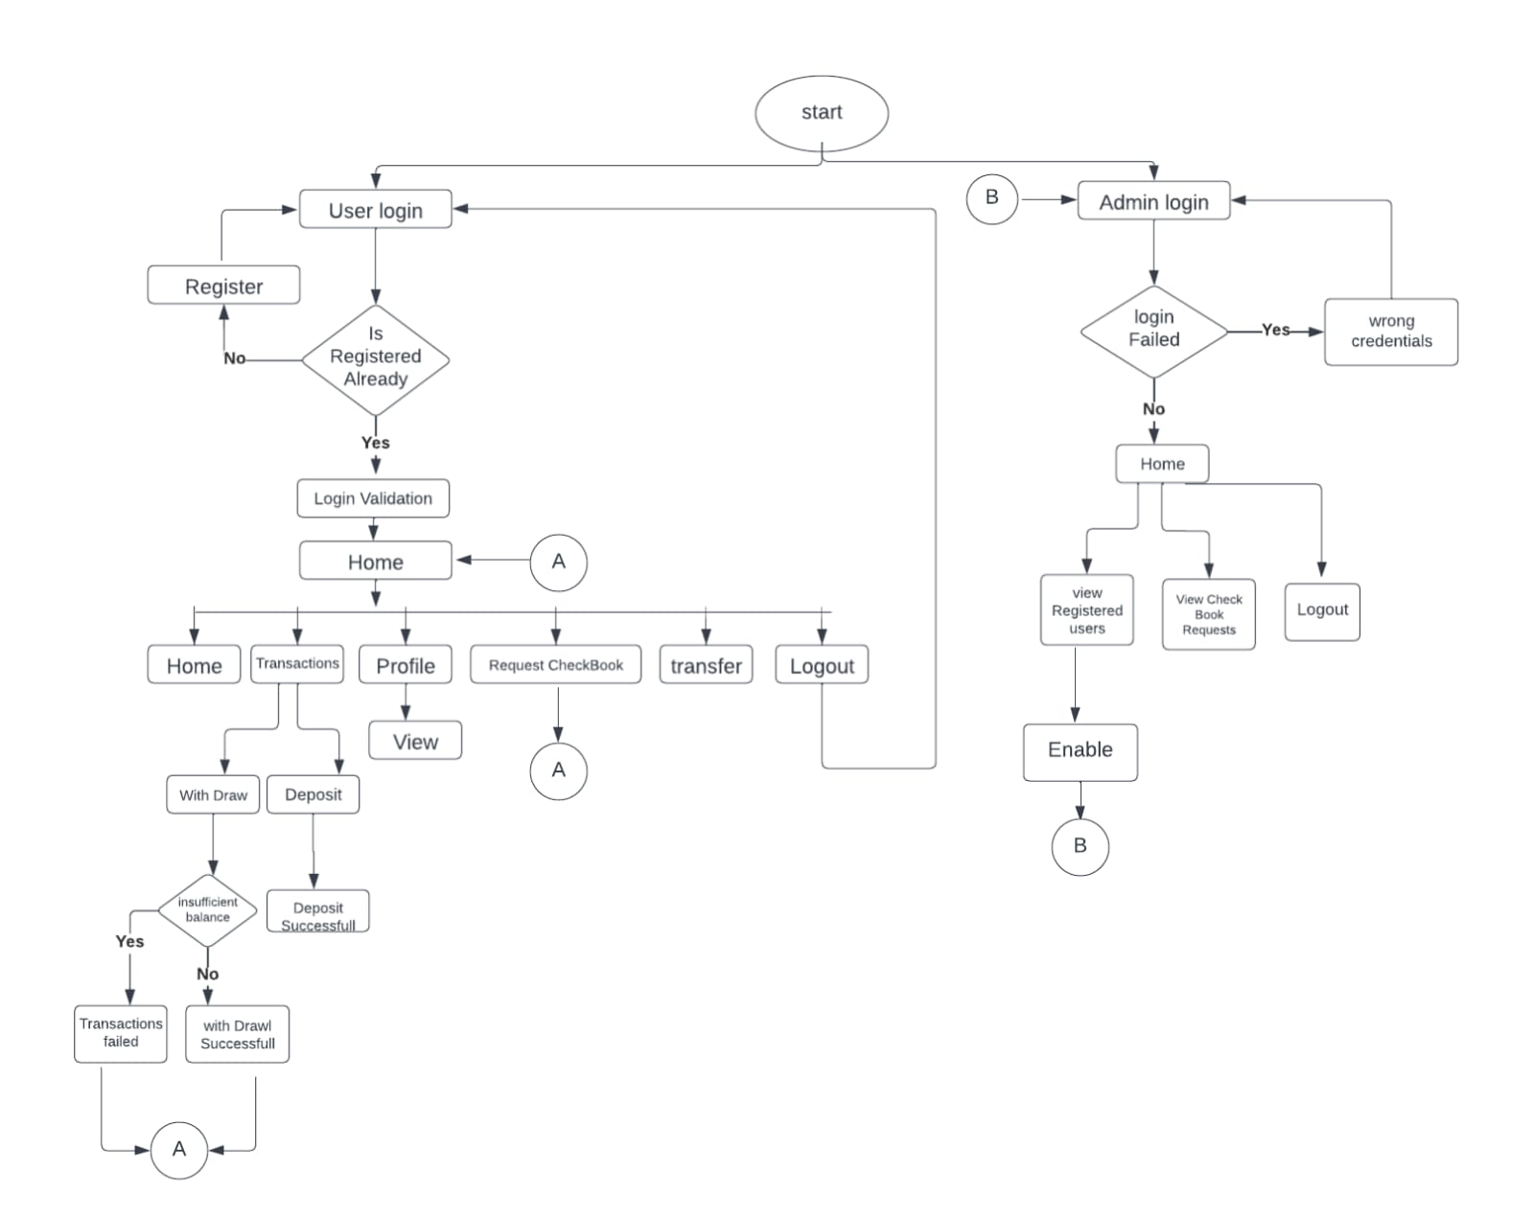
FLOW CHART

Slide 15
Online banking app microservice architecture
Online Banking Application
MICROSERVICE-1
MICROSERVICE-2
MICROSERVICE-3
DB

Slide 16
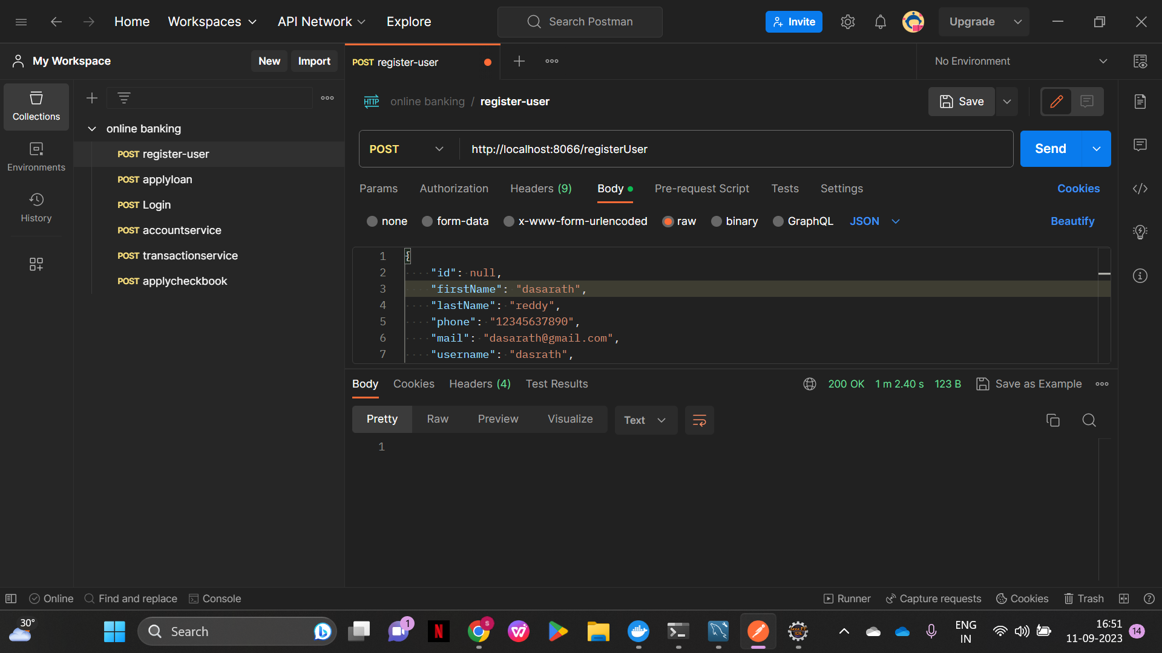
Output : Register

Slide 17
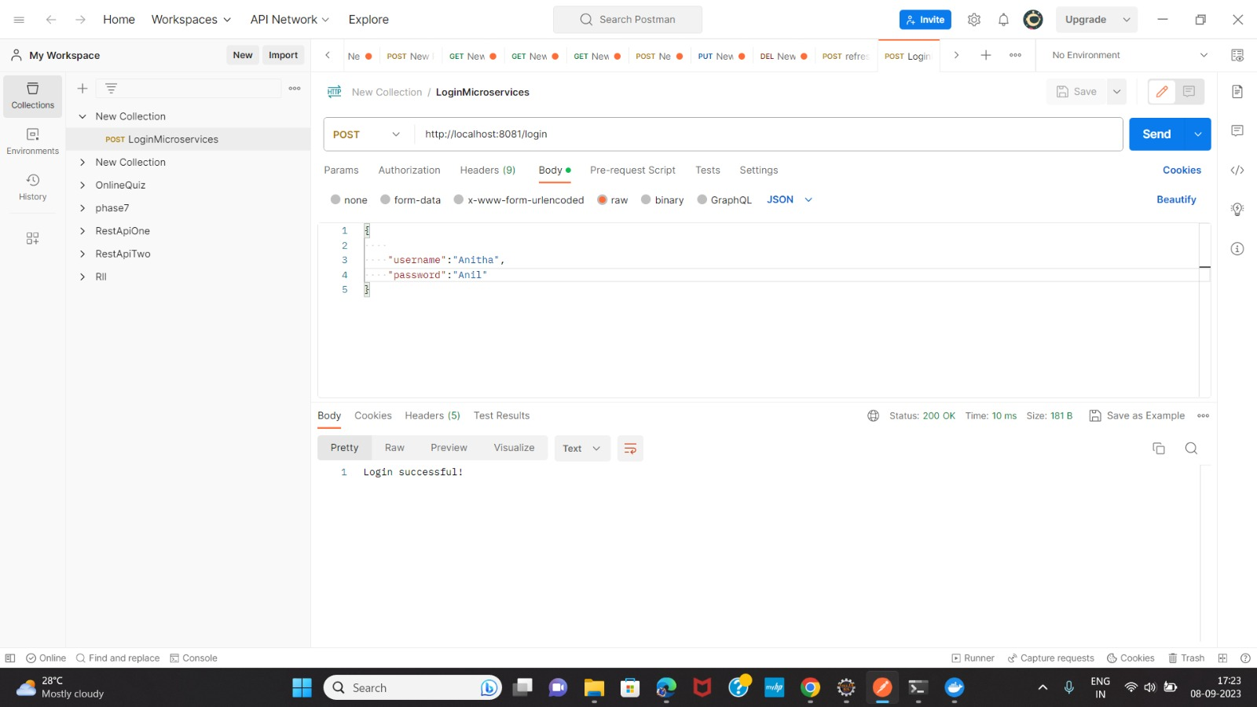
Login:

Slide 18
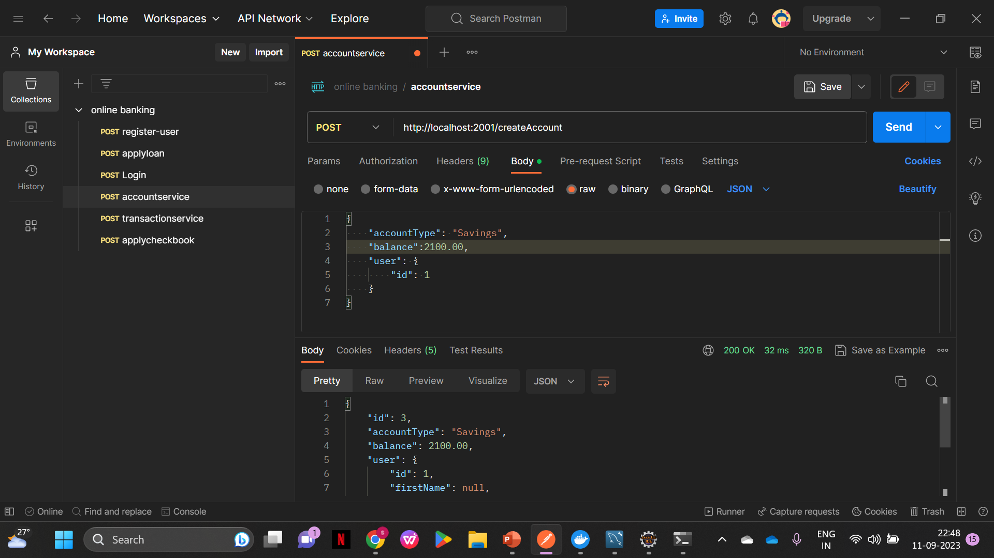
Accounts:

Slide 19
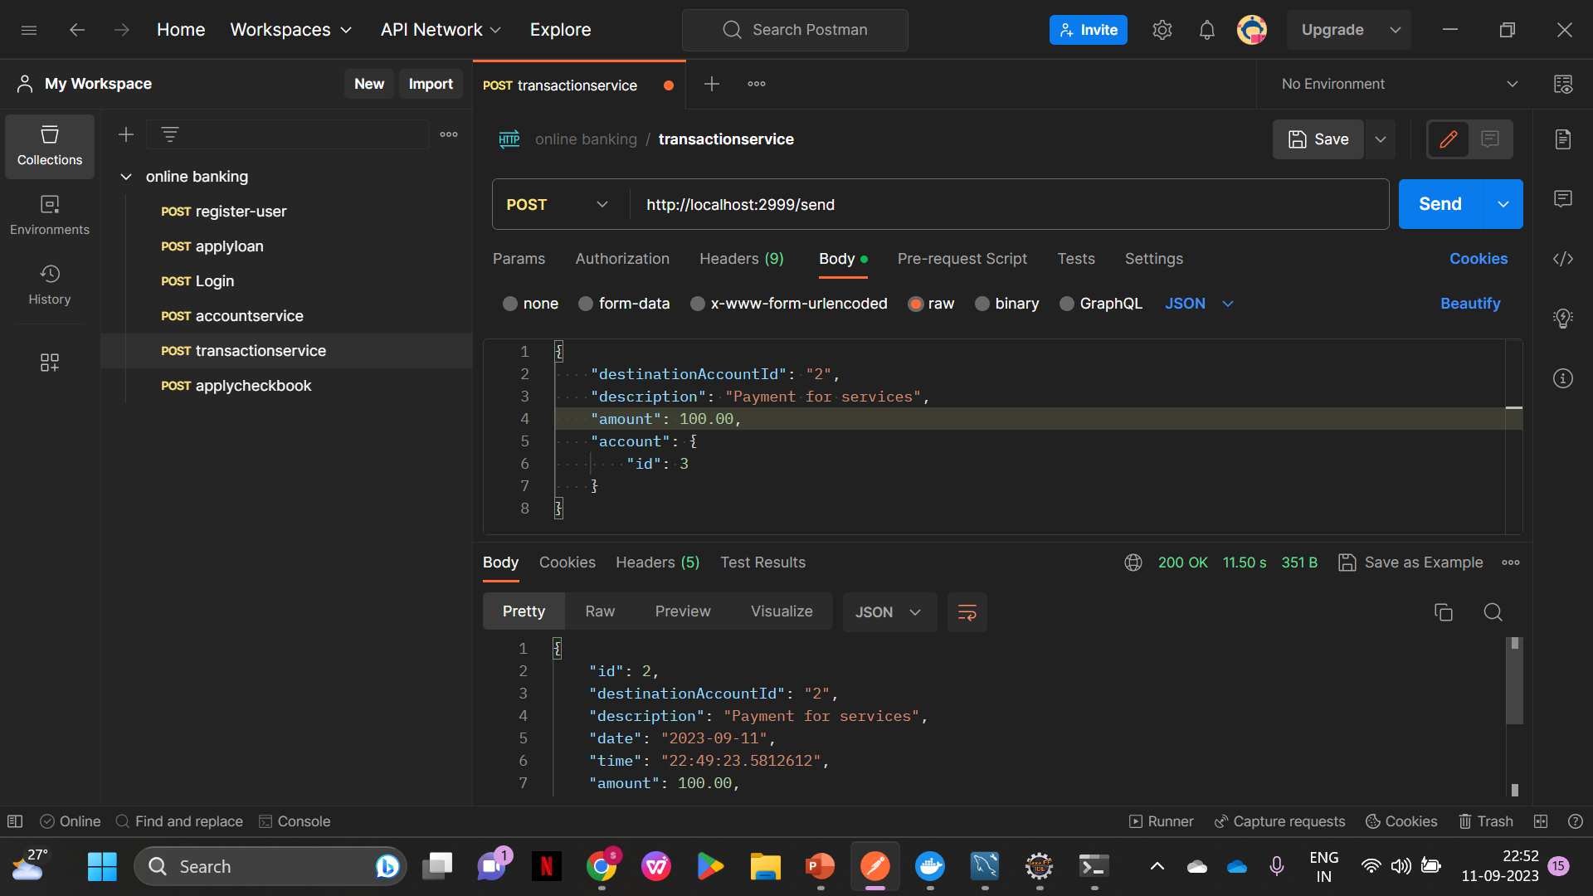
Transaction:

Slide 20
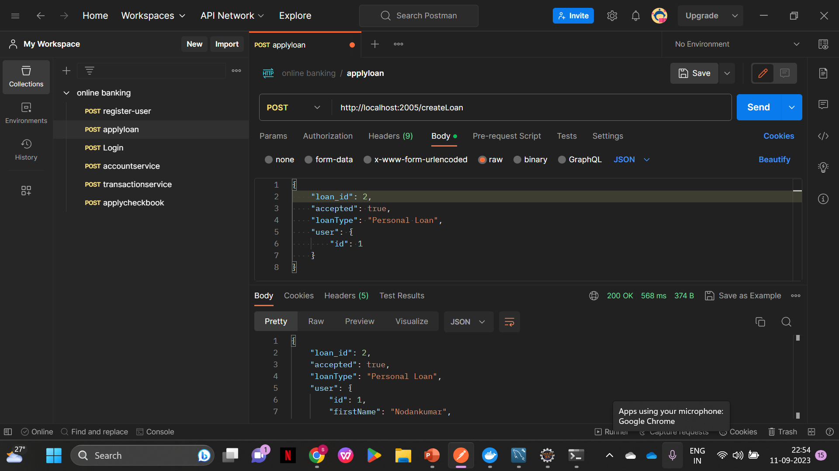
Loans:

Slide 21
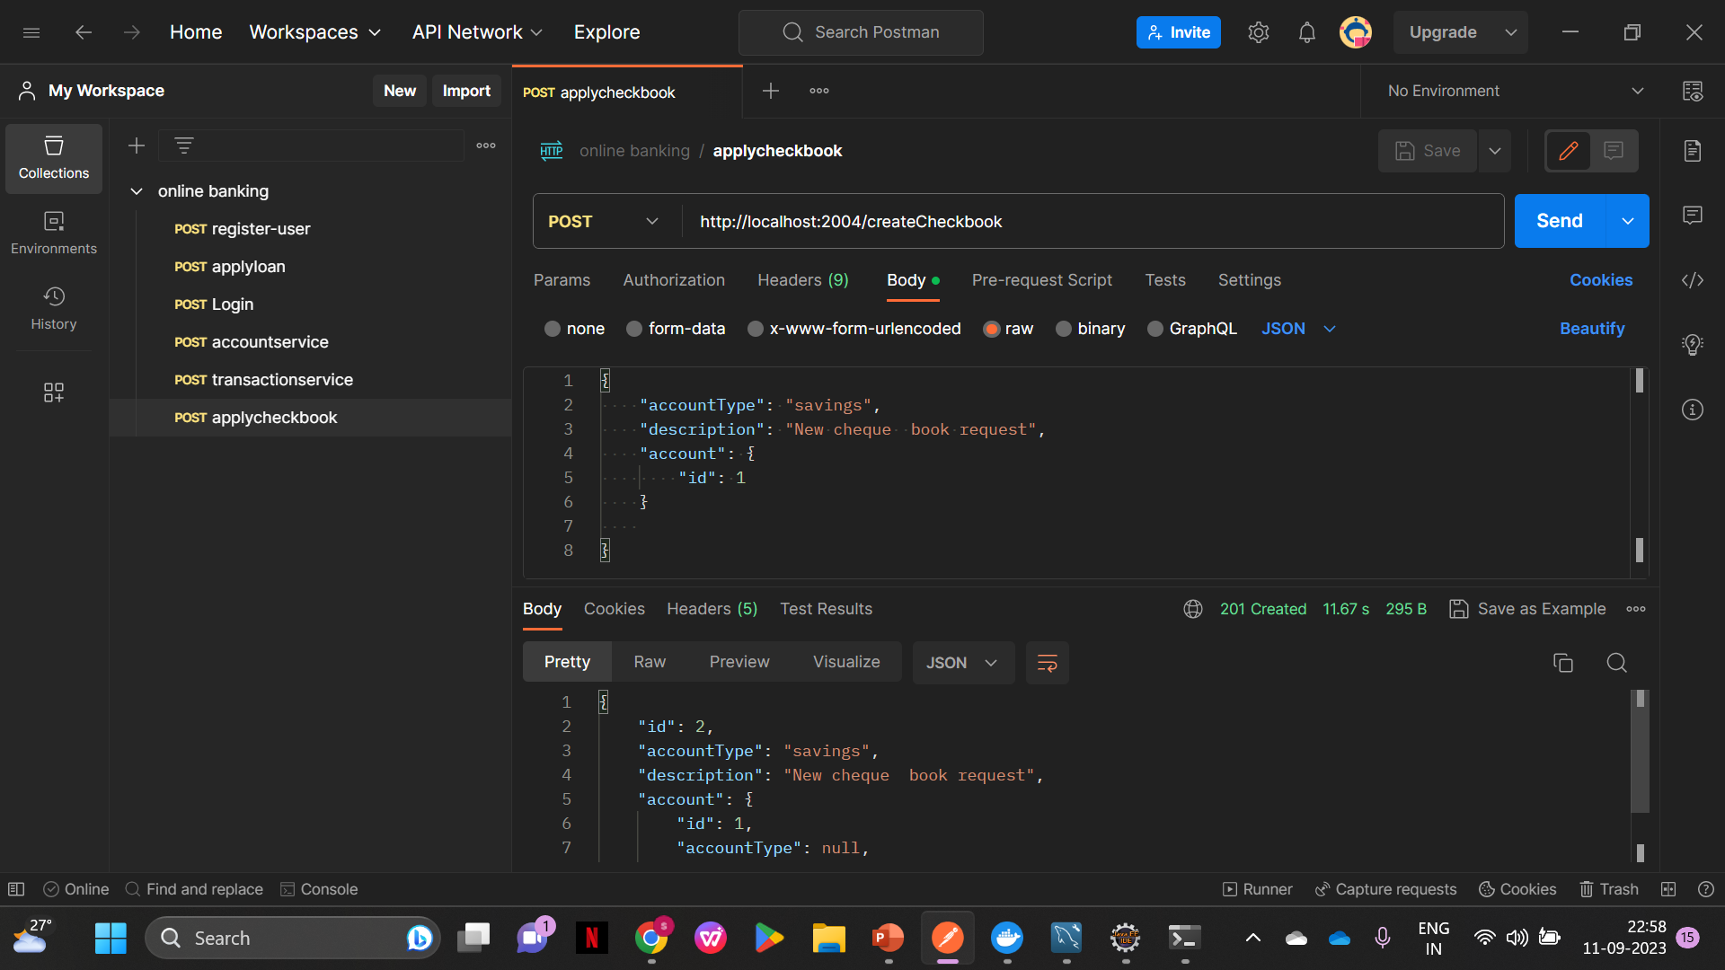
ChequeBook:

Slide 22
Register And User:
UserRegistrationController is used to register users by receiving user data via HTTP POST requests, logging the received data, and forwarding it to a UserRegistrationProxy for actual user registration processing.
Spring Boot controller (UserController) is responsible for handling HTTP requests related to user data, including fetching user details by ID or username and retrieving a list of all users. It interacts with an external service through a UserProxy component and incorporates resilience patterns (circuit breaker and retry) using Resilience4j annotations to enhance the reliability of service calls. Additionally, it includes logging to track input parameters and results for debugging and monitoring purposes.

Slide 23
Login:
This controller is responsible for handling HTTP POST requests related to user login functionality in a microservices architecture. It communicates with a Login Service Proxy to facilitate user authentication.
The code defines a single endpoint, POST , which is used for user login.
It accepts JSON objects (Login requests) in the request body.
The response is expected to be a string, likely indicating the result of the login attempt. Whether the user logged in successfully or not.

Slide 24
Account:
This controller is responsible for managing account-related operations, particularly withdrawals, in a financial application. It communicates with an external service through an AccountProxy for account operations.
Various HTTP endpoints are defined to handle account-related operations:
GET /getAllAccounts: Retrieves a list of all accounts.
GET /get-account/{id}: Retrieves account information by ID.
GET /withdraw/{id}/{balance}: Initiates a withdrawal of a specified amount from an account.
POST /createAccount: Creates a new account.
For Deposit:
GET /deposit/{id}/{balance}: Initiates a withdrawal of a specified amount from an account.

Slide 25
Transaction:
This controller manages HTTP requests related to financial transactions, acting as an interface between the client and a microservice responsible for transaction operations. The controller communicates with the microservice using a TransactionProxy.
Various HTTP endpoints are defined to handle transaction-related operations:
GET /getAllTransactions: Retrieves a list of all transactions.
GET /transaction/{destinationAccountId}: Retrieves transactions by a destination account ID.
POST /send: Inserts a new transaction.
GET /getTransactionById/{id}: Retrieves a transaction by its ID.
GET /getTransaction/account/{id}: Retrieves transactions by account ID.

Slide 26
Loan:
This controller handles HTTP requests related to Loans, including retrieving all loans, retrieving a loan by its ID, creating a new loan, and handling loan confirmation requests.
GET /getAllLoans: Retrieves a list of all loans.
GET /getLoan/{loan_id}: Retrieves a loan by its ID.
POST /createLoan: Creates a new loan.
GET /admin/confirmLoanTrue/{id}: Confirms a loan request as true.
GET /admin/confirmLoanFalse/{id}: Confirms a loan request as false.

Slide 27
chequebook:
This controller manages ChequeBook-related operations, such as retrieving all ChequeBooks, retrieving a ChequeBook by its ID, and creating a new ChequeBook.
GET /getallCheckbooks: Retrieves a list of all ChequeBooks.
GET /getCheckbookbyId/{id}: Retrieves a ChequeBook by its ID.
POST /createCheckbook: Creates a new ChequeBook.
The controller uses SLF4J for logging important events and information, allowing for debugging and monitoring.

Slide 28
Conclusion
Our Project in a Nutshell:
In summary , ICIN, a leading banking firm, is making a strategic move towards developing a modern online banking system using Java Microservices and Spring Cloud Architecture. This transition is driven by the need to remain competitive in the ever-evolving banking industry, where online banking systems like AXIS and American Express have gained prominence.
The new system aims to offer a user-friendly experience with a wide range of features, that includes accounts, transactions. It leverages Java Microservices and Spring Cloud to provide scalability, reliability, security, and flexibility. By adopting these modern technologies ICIN can enhance its digital presence, stay competitive, and cater to the changing demands of its customers.

Slide 29


